Slide 1

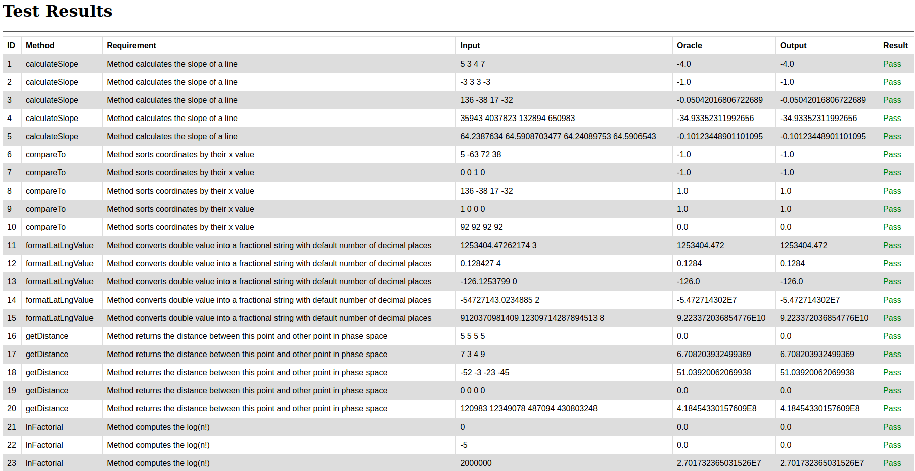
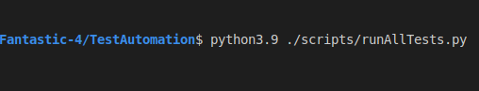

Automated Testing Framework for
Spatiotemporal Epidemiological Modeler (STEM)
Ashanti Long, Clare Clever, Jim Bowring, Katherine Sweeney
College of Charleston
Introduction
In this project we constructed an automated testing framework for the STEM application. The script we built for this project runs in a Linux environment and executes 25 test cases.
Results
The STEM engine manipulates data taken as input to produce spatiotemporal models. To do this the code utilizes a plethora of mathematical functions. These functions are needed to compute related statistical values for modeling purposes. Most of the methods that we were interested in testing were methods related to mathematical calculations. The five methods we tested were: lnFactorial, getDistance, compareTo, calculateSlope, and formatLatLngValue. We created 5 tests for each method for a total of 25 test cases. The resulting output is shown below…
Conclusion
Working on this project was an incredible experience. We found that it was crucial to fully test each method. Faults can exist that are not going to cause errors to be thrown but could cause the method to behave in a way that it is not supposed to. This project demonstrated the importance of double-checking things. Additionally, we learned how to implement test cases to catch potential logic errors. Subsequently shining a light on the idea that errors are not going to be caught by the compiler 100% of the time. Logic errors need to be found via exhaustive testing, or through additional human scrutinization of the code.
Materials and methods
The items used for this project were GitHub, Java, Linux, Python and the STEM code base.
The script runs via the command-line interface (CLI) and utilizes bash commands to test each method.
Acknowledgments
We would love to thank Jim Bowring for his immense help throughout the duration of this project.
CLI command
Further information
https://github.com/csci-362-02-2020/Fantastic-4
Bash commands

